Slide 1
Attention HTR
Attention HTR: Handwritten Text Recognition
Based on Attention Encoder-Decoder Networks
By Dmitrijs Kass and Ekta Vats
Uppsala University, Sweden
Arxiv paper(Research paper published by Cornell University)
Reference link:
Dmitrijs Kass et. al 2022
Team Members:
Nikhil CS,422229
Kushal C,422204
Sai Kaustuv,422248
Special Acknowledgement:
We extend our sincere gratitude to faculty members, Gireesh Sir, Shashank Sir, and Dr. Himabindu Ma'am, for their invaluable guidance and support throughout this project.

Slide 2
Abstract
This work proposes an attention-based sequence-to-sequence model for handwritten text recognition (HTR). It explores transfer learning for data-efficient training and leverages pre-trained models on scene text images.
Handwritten Text Recognition (HTR) is a challenging task in computer vision and NLP.
The proposed model uses ResNet for feature extraction and BiLSTM for sequence modeling
Objectives:
1. Develop an end-to-end attention-based model for HTR.
2. Utilize transfer learning for better performance.
3. Evaluate the model if possible on diverse handwriting datasets.
Observe certain metrics to decide how good model perform

Slide 3
Problem Statement
Traditional HTR models require large labeled datasets, which are scarce.
This work aims to improve HTR by leveraging pre-trained models and attention mechanisms.
Various sequence-to-sequence models have been proposed for text recognition.
Most rely on large labeled datasets, making training costly.

Slide 4
Novelty and uniqueness of model proposed
s. (a) The goal of this work is to leverage transfer learning to enable HTR in cases where training data is scarce.
(b) Scene text images and a new dataset, Imgur5K [13], are used for transfer learning. The Imgur5K dataset contains a handwritten text by approximately 5000 writers, which allows our proposed model to generalize better on unseen examples.
(c) The proposed attention-based architecture is simple, modular, and reproducible, more data can be easily added in the pipeline, further strengthening the model’s accuracy.
(d) A comprehensive error analysis using different techniques such as bias-variance analysis, character-level analysis, and visual analysis is presented.
(e) An ablation study is conducted to demonstrate the importance of the proposed framework

Slide 5
Methodology - Overview
The proposed HTR model consists of:
- Feature extraction using ResNet.
- Sequence modeling with BiLSTM.
- Decoder with attention mechanism.
Datasets used include IAM and Imgur5K for handwriting recognition.
Data preprocessing involves normalization and
Other procedures covered later on

Slide 6
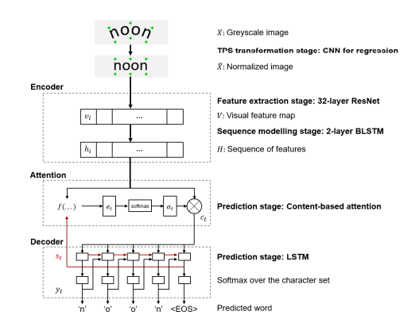
Model Architecture(reffered from research paper)
Dmitrijs Kass et. al 2022

Slide 7
1)Transformation stage:
• Handwritten words often appear in irregular shapes (tilted, skewed, curved).
• Thin-plate spline (TPS) transformation normalizes word images.
• A CNN-based localization network detects fiducial points for shape normalization.
• A grid generator and sampler adjust the image to a standard form.
2)Feature Extraction Stage:
• A 32-layer residual neural network (ResNet) encodes input images.
• Input: 100×32 grayscale image.
• Output: 2D visual feature map with 512 channels and 26 columns.
• Each column corresponds to a region in the transformed image.
3)Sequence Modelling stage
• The extracted feature map is reshaped into a sequence of features.
• A bidirectional LSTM (BLSTM) models sequence dependencies.
• BLSTM captures contextual information from both sides.
• Two stacked BLSTMs improve abstraction and recognition accuracy.
4) Prediction stage
• An attention-based decoder improves character sequence prediction.
• A unidirectional LSTM generates output one character at a time.
• The decoder dynamically focuses on different parts of the feature sequence.
• The model supports variable-length predictions with a fixed maximum length.

Slide 8
Character Set and Final Output
• The model supports case-insensitive and case-sensitive recognition.
• Case-insensitive model: 37 characters (26 lowercase letters, 10 digits, EOS token).
• Case-sensitive model: 95 characters (uppercase letters, digits, special symbols).
• The decoder stops generating characters upon predicting the EOS token.

Slide 9
Experimental Setup
The model was implemented in PyTorch with single GPU.
The research paper proposed usage of multiple GPUs for larger datasets such as Imgur5K multiwriter dataset
Dependencies :apart from the table the rest of the dependencies used remained the same as provided in requirements.txt such as lmdb library module etc.
1. Transfer learning improves performance with limited data.
2. Attention mechanism enhances text recognition accuracy..
Suggested by research paper | Used by us as per keggle environment
CentOS Linux release 7.9.2009 (Core) | Windows
Python 3.6.8 | Python 3.11
PyTorch 1.9.0,CUDA 11.5 | PyTorch 2.5.1,cu121

Slide 10
Challenges Faced and real world applications
Challenges faced:
1. Variability in handwriting styles.
2. Limited labeled datasets.
3. Model generalization across different scripts.
Real world applications:
1. Digitization of historical manuscripts.
2. Automatic transcription for medical records.
3. Assistive technology for visually impaired individuals.

Slide 11
Limitations of the Model
The model’s errors pass a sanity check as the confusion matrix highlights that the most typical errors are between characters having similar ways of writing. For example, a is most often confused with o, and q with g.
– Letters z, q, j and x and all digits are significantly under-represented in the distribution of characters.
– In general, a lower probability mass of a character leads to a lower F1 score. However, the uniqueness of a character’s way of writing seems to be an important factor. For example, digits 0 and 3 have approximately the same probability mass but hugely different F1 scores (77% and 97%). This difference is attributed to the fact that digit 3 is relatively unique and is, therefore, more difficult to confuse with other characters. The same conclusion applies to letter x, which achieves a relatively high F1 score despite being among the least frequent characters. Intuitively, characters that are somewhat unique in the way they are written need fewer examples in the training set to achieve high F1 scores. This also suggests that F1 scores can be used to prioritize characters for inclusion in the data augmentation, as a possible next step to improve the model’s performance.

Slide 12
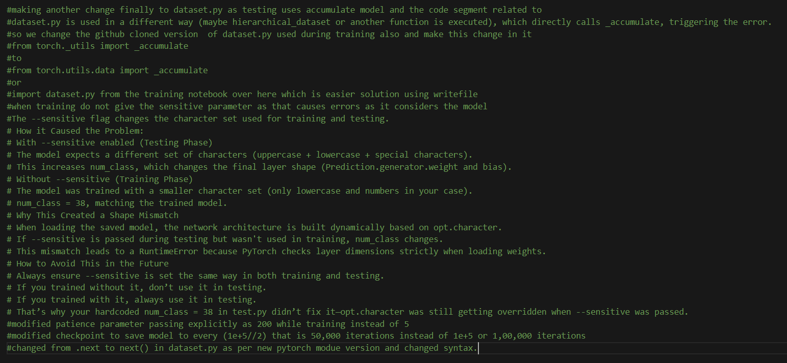
CHANGES MADE TO EXISTING CODE TO MAKE IT WORK IN LOCAL SYSTEM

Slide 13
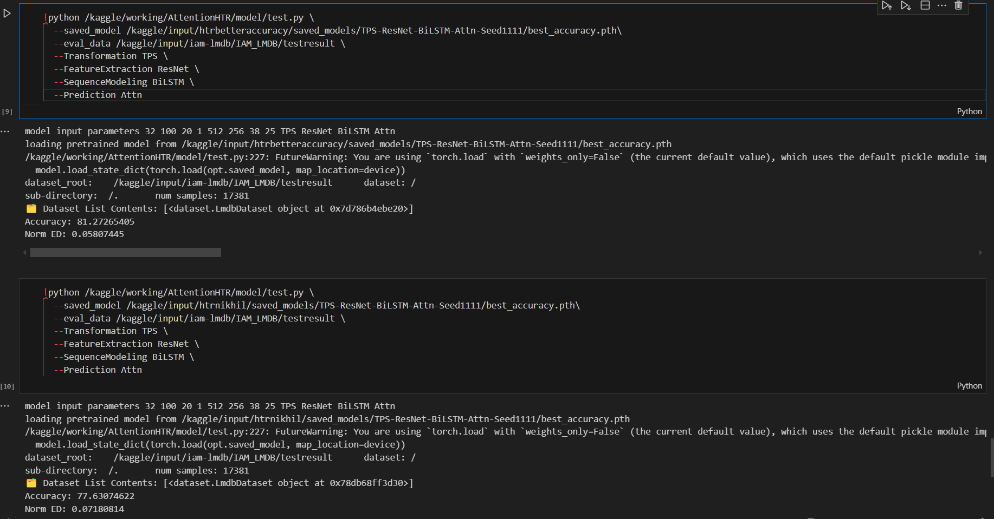
Parameters recorded

Slide 14
Model architecture pipeline modifications experimented with
Measurement metrics(accuracy,norm_ed,train loss,valid loss)
Changed the pre existing feature extractor layer of the model architecture pipeline from resnet(residual network model) to a Visual Transformer(Vit_b_16 model) and noted changes in measurement metrics
Changed the pre existing decoder layer of the model architecture pipeline from BiLSTM to a Visual Transformer(custom VIT) and noted changes in measurement metrics
Changed the pre existing feature extractor layer of the model architecture pipeline from resnet(residual network model) to a custom resnet(6 layers)+NeuralODE(1 layer) model and noted changes in measurement metrics
Changed the pre existing feature extractor layer of the model architecture pipeline from resnet(residual network model) to a RCNN model and noted changes in measurement metrics
Changed the pre existing feature extractor layer of the model architecture pipeline from resnet(residual network model) to a VGG model and noted changes in measurement metrics

Slide 15
Modification1 (feature extraction layer resnet → resnet(6 layers)+neuralode(1 layer)
WHY NEURAL ODE IS CHOSEN OVER RESNET
1) Neural ode offers a memory-efficient feature extractor by modeling feature transformations as continuous flows rather than stacked layers, which is beneficial for limited gpu systems in handwritten text recognition (htr). 2) It adapts computation based on image complexity, allowing dynamic depth for feature extraction — less computation for simple words and more for complex handwriting. 3) It reduces model overfitting risk by using fewer parameters and output channels while preserving accuracy, which is critical when training on small datasets like iam words. ADVANTAGES AND DISADVANTAGES OF NEURAL ODE: Advantages: • Smooth continuous feature transformation — captures fine variations in handwriting strokes effectively. • Constant GPU memory usage during backpropagation — enables larger batch sizes or higher resolution images. • Fewer model parameters and output channels — reduces risk of overfitting on small datasets. • Adaptive computation — automatically adjusts effort for each image based on difficulty. • Natural fit for sequence-like data such as handwriting — mimics continuous flow of pen strokes. • Reversible computation — theoretical ability to recover input features from output (useful in debugging and interpretability). Disadvantages: • Slower inference time due to numerical solver overhead (ODE solver requires multiple evaluations during forward pass). • More sensitive to hyperparameter tuning (solver settings, time step size, etc.) — harder to optimize than ResNet. • Complex implementation compared to traditional convolutional layers — increases development/debugging effort.

Slide 16
why neuralode ideally gives faster training & needs fewer channels with less backpropogation time
- continuous-depth learning: neuralode models feature transformation as a smooth, continuous process (like following a path), not discrete stacked layers.
- fewer parameters: instead of stacking many layers (like resnet), neuralode solves a differential equation with fewer intermediate states — so fewer output channels are needed.
- lighter computations: because it computes only necessary intermediate steps (adaptive solvers), backpropagation time can be less compared to deep stack models.
- stable gradients: smoother transformations mean less vanishing/exploding gradient risk, allowing stable and efficient backward pass.
- compact model: with fewer output channels, the feature maps (activations) are smaller — reducing GPU memory usage. - in attention HTR: by using neuralode as feature extractor, less feature redundancy is captured (no need to stack many conv filters), still preserving character-level spatial info.

Slide 17
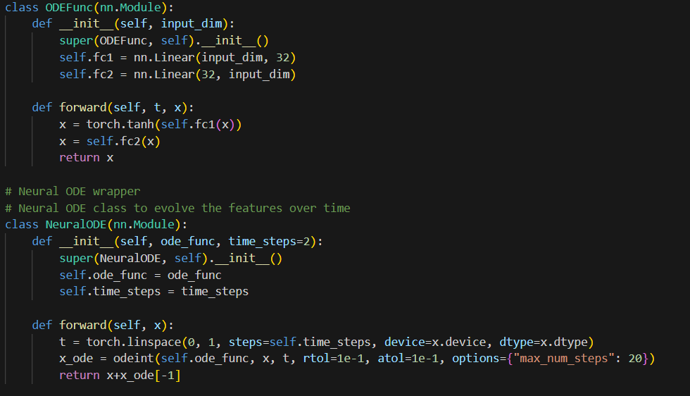
neuralODE class

Slide 18
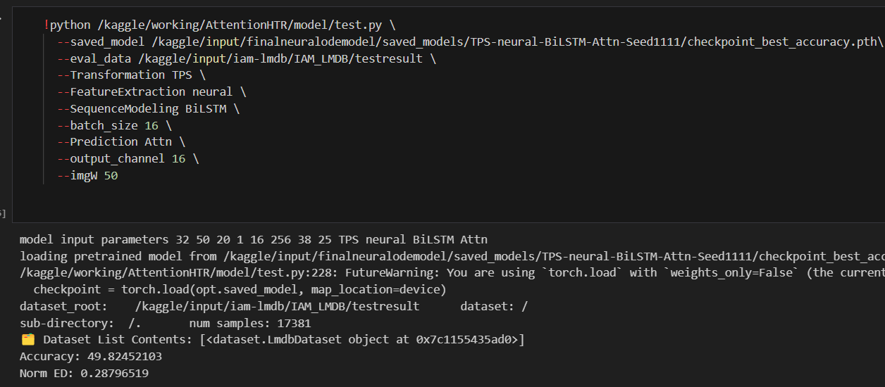
Tested accuracy

Slide 19
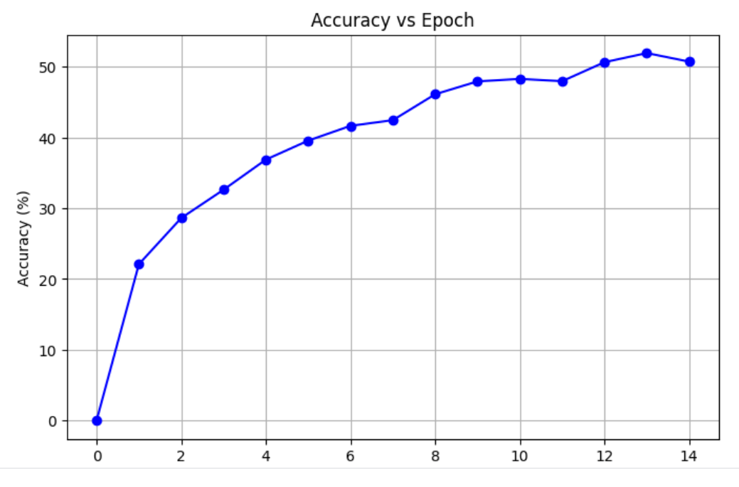
Graphs related to training
Accuracy(y-axis) vs epochs(x-axis) for neuralODE+RESNET feature extraction based model pipeline

Slide 20
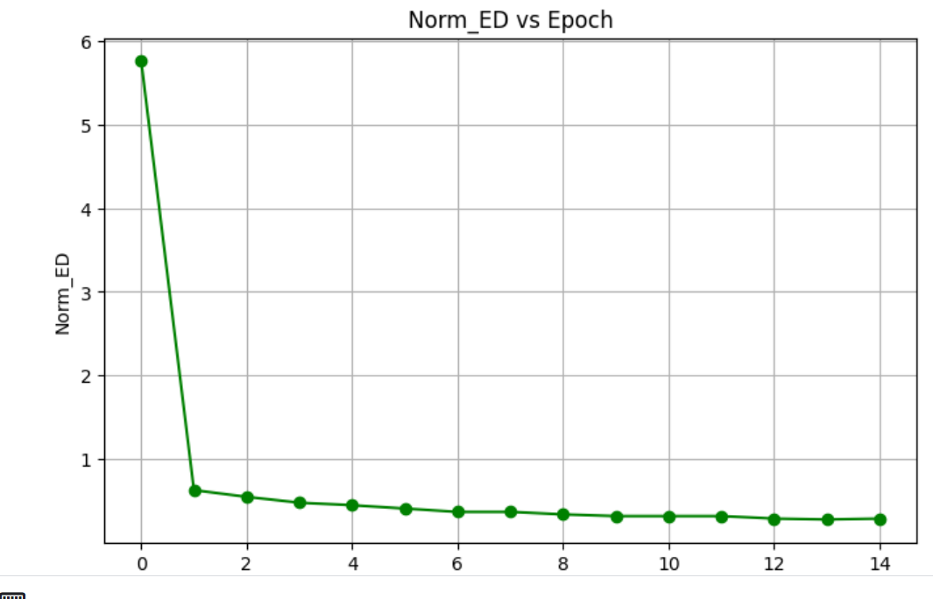
NORM_ED(normal edit distance)(y-axis) vs epochs(x-axis) for neuralODE+RESNET feature extraction based model pipeline

Slide 21
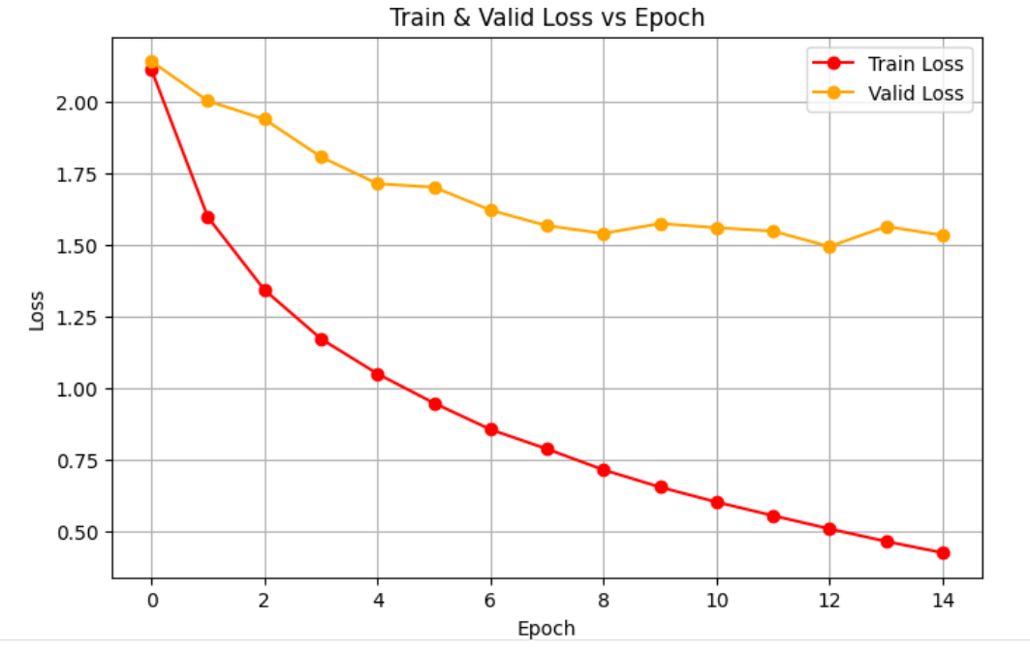
Train_loss and valid_loss(y-axis) vs epochs(x-axis) for neuralODE+RESNET feature extraction based model pipeline

Slide 22
Modificatoin-2(resnet→vit)
Why Vision Transformer (ViT)?
Direct Global Attention ViT computes attention over all image patches simultaneously. Unlike ResNet’s local convolutions (which aggregate features progressively across layers), ViT allows every patch to directly interact with every other patch in a single step. This can capture global spatial relationships more explicitly and earlier in the network, which may benefit complex or widely spread text patterns.
Uniform Feature Processing In convolutional networks like ResNet, center pixels often get emphasized due to overlapping receptive fields and stride patterns. ViT treats each patch equally, without any spatial bias or preference for certain regions. This uniformity ensures that important strokes or characters located at the periphery of handwritten text (edges, margins) receive equal attention as central regions.
Better Modeling of Long-range Dependencies For handwritten text recognition, especially long lines of text or irregular cursive handwriting, dependencies between distant characters matter (e.g., character context across entire words). ViT excels at capturing dependencies between distant regions, allowing better holistic understanding of entire words or sequences — potentially improving word-level recognition compared to ResNet’s more localized focus.
By replacing ResNet with ViT, we aim to leverage stronger global context modeling, uniform feature extraction, and enhanced long-range dependency capture, which are crucial for accurate recognition of complex handwritten text sequences.

Slide 23
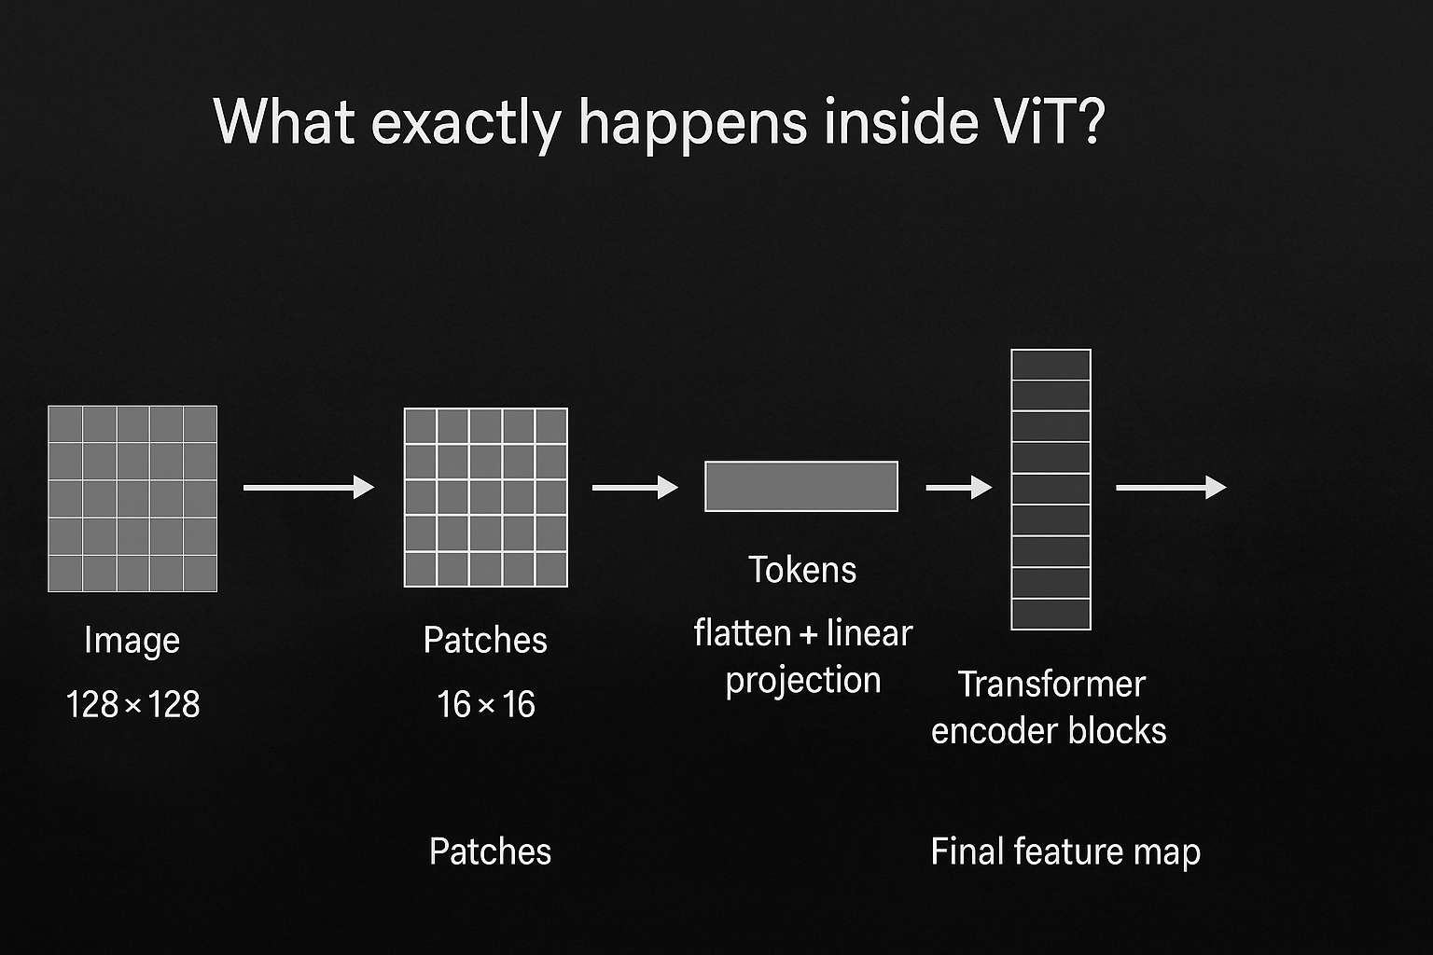
Advantages and disadvantages of vit replacing resnet
Pros of ViT over ResNet
Immediate global interactions (not hierarchical approximation).
Parameter efficiency: Fewer layers may achieve similar expressiveness in global reasoning.
Natural fit for variable-sized and irregular handwriting patterns.
Cons of vit over resnet:
Loss of strong spatial priors (convolutions are naturally translation-invariant, helpful for strokes).
Higher computational overhead without careful tuning.The GPU offered in Kaggle having only capacity of 16GB in total acts as a hindrance for training a vit based model in large scale
Needs larger datasets to fully leverage ViT’s capacity.The IAM words dataset itself consists of only a total of 70000 images of words out of which 6127 of them is used as a validation dataset and another 17137 of them is used as a testing dataset and the rest 41167 is used for training

Slide 24
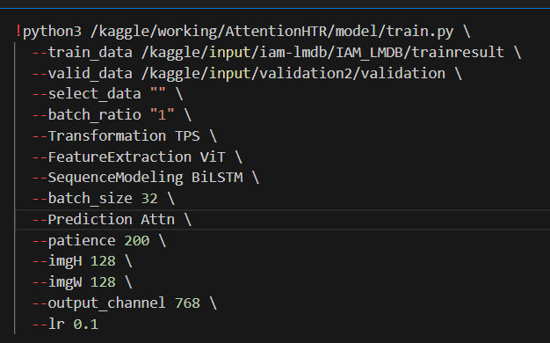
Training parameters for the training of vit_b_16 feature extractor based model pipeline
The image height and image width was changed from 32x100 default configuration to 128x128 configuration so that both dimensions are divisible by 16 as patch size is 16 for vit_b_16 model where b stands for base type model. The model is trained from scratch once it is imported from torchvision.
Output channels are changed from default 512 to 768 for more detailed featuring of each individual image leading to better accuracy but this caused more memory overhead.Batch size changed from default 192 to 32 to handle memory overhead .
The vit model returns an output tensor of type [B,H,W,C] where
B=Batch Size,H=height,W=width,C=channels so modified output tensor to form [B,SEQ_LEN,C] where sequence length of feature vector=H*W.

Slide 25
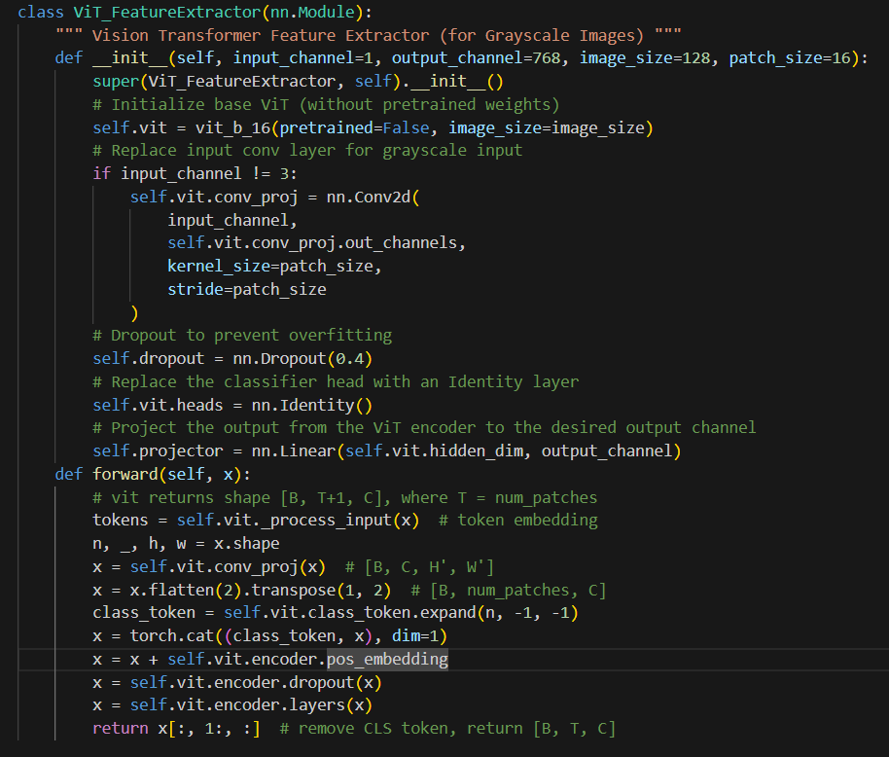
Vit feature extractor class code

Slide 26

Regularization strategies adopted across 3 training attempts to get the best accuracy
1)Added norm dropout withing the model itself before forwardPass so that 40% of neurons are forgotten after each epoch to prevent overconfidence and memorization of words
2)added a scheduler for learning rate to reduce learning rate by a factor of 2 for every 5 early stopping epochs
Definition of scheduler:
scheduler = torch.optim.lr_scheduler.ReduceLROnPlateau(optimizer, 'min', patience=5, factor=0.5)
Calling the scheduler on valid loss for each epoch of validation:
scheduler.step(valid_loss)

Slide 27
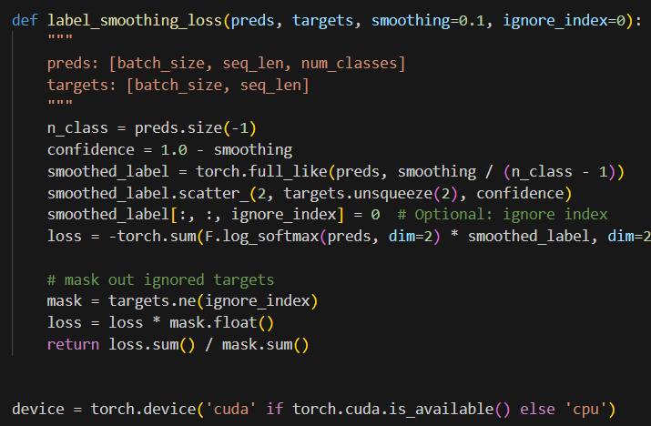

3)added a label smoother which will cloud the labels by applying a softmax such that confidence on predictions of words don’t go to extremes:
Before label smoothing: after label smoothing
Ground truth | prediction | confidence
cat | sat | 0
bat | bat | 1
rat | rack | 0
Ground truth | prediction | confidence
cat | sat | 0.33
bat | bat | 0.66
rat | rack | 0.33

Slide 28
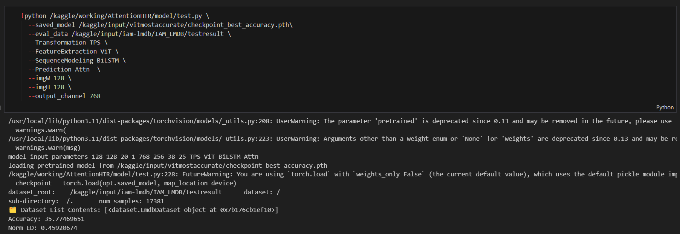
Tested results of accuracy

Slide 29
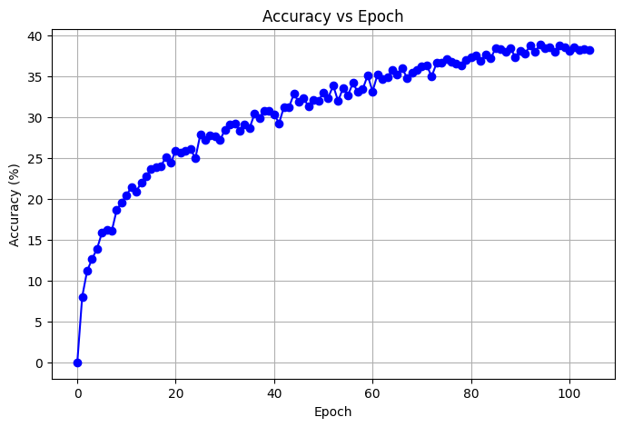
Graphs related to training
Accuracy(y-axis) vs epochs(x-axis) for VIT_b_16 feature extraction based model pipeline

Slide 30
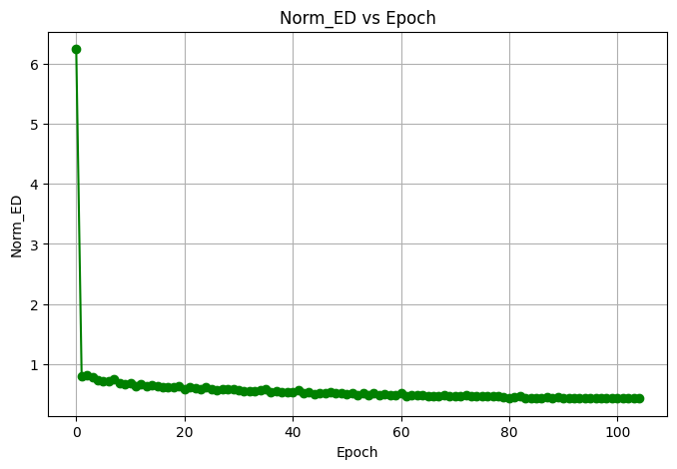
NORM_ED(normal edit distance)(y-axis) vs epochs(x-axis) for VIT_b_16 feature extraction based model pipeline

Slide 31
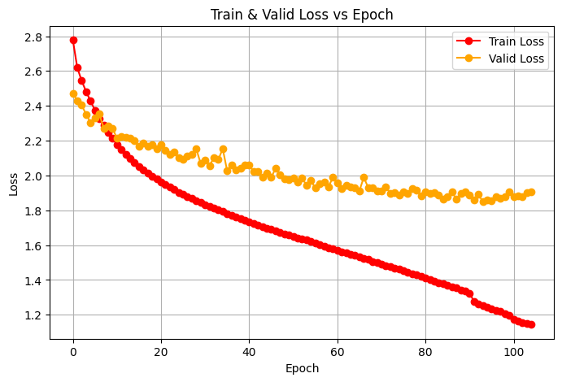
Train_loss and valid_loss(y-axis) vs epochs(x-axis) for VIT_b_16 feature extraction based model pipeline

Slide 32
Modification-3(resnet → rcnn)
Why Replace ResNet with RCNN?
Region-Focused Feature Extraction: RCNN explicitly detects and focuses on regions of interest (e.g., characters or word-parts) rather than processing the entire image uniformly.
Better Localization: Helps in complex handwriting where words or characters are scattered, slanted, or irregularly spaced.
Adaptive Attention: Allows the model to attend selectively to informative parts of the image, rather than relying on fixed receptive fields.

Slide 33
Advantages and Disadvantages of replacing resnet with rcnn model
Advantages of RCNN Feature Extractor
Handles Complex Layouts Better — Effective for text with irregular spacing, noise, or overlapping strokes. Explicit Focus on Characters — Improves recognition of small or fine-grained details. Potential Accuracy Gain — For challenging handwritten text, region proposals give more precise features.
Disadvantages of RCNN Feature Extractor
Slower Training & Inference — Region proposals introduce additional computational overhead. More Complex Pipeline — Integration with sequence models becomes harder than with ResNet's dense features. Higher Memory Usage — Especially when many proposals are generated per image.
Similar to the vit model I have made use of the regularization strategies of norm dropout of 0.4,labelsmoothing and a learning rate scheduler which are having same parameters as the ones used for training the vit based model

Slide 34
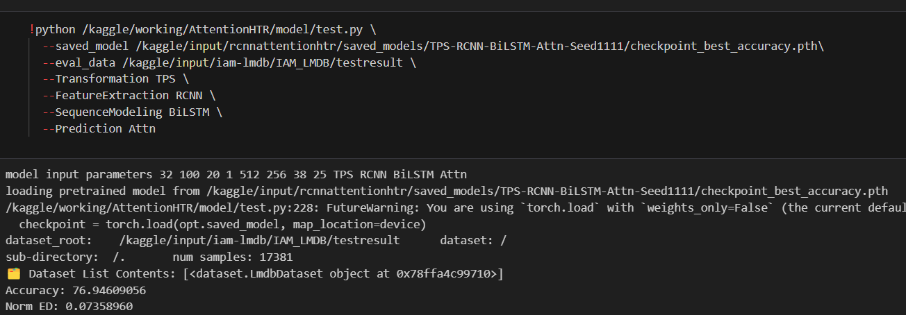
Tested results of accuracy

Slide 35
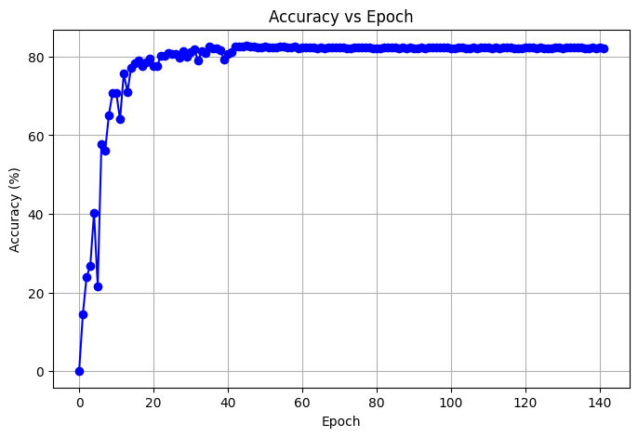
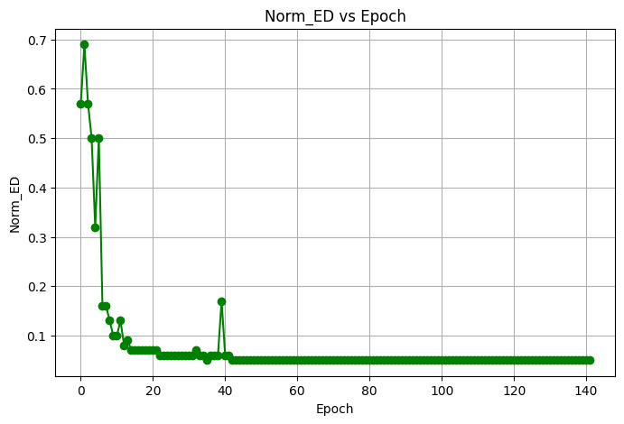
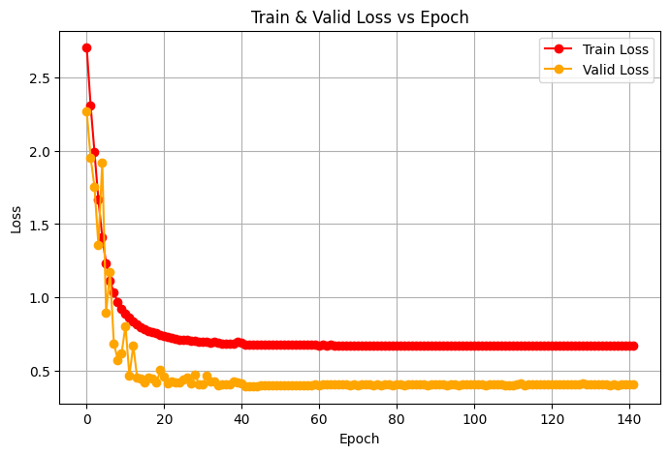
1)Accuracy(y-axis) vs epochs(x-axis) for rcnn feature extraction based model pipeline 2) NORM_ED(normal edit distance)(y-axis) vs epochs(x-axis) for rcnn feature extraction based model pipeline 3)Train_loss and valid_loss(y-axis) vs epochs(x-axis) for rcnn feature extraction based model pipeline

Slide 36
Modification4(decoder layer bilstm → custom vit model)
Major Modifications Replaced BiLSTM with custom Vision Transformer (ViT) for sequence modeling Integrated ResNet for robust feature extraction (512 channels) Implemented Attention decoder for precise character prediction
Performance Highlights
Achieved ~30% accuracy on standard benchmark datasets
Reduced Normalized Edit Distance to ~1.5 Training on 115,320 samples from IAM_LMDB dataset
Benefits of Our Approach
1. Better context understanding: Captures relationships between characters
2. Robustness to variations: Handles different writing styles and slants
3. Efficiency: Optimized model size while maintaining performance
4. End-to-end training: All components trained jointly for handwriting recognition

Slide 37
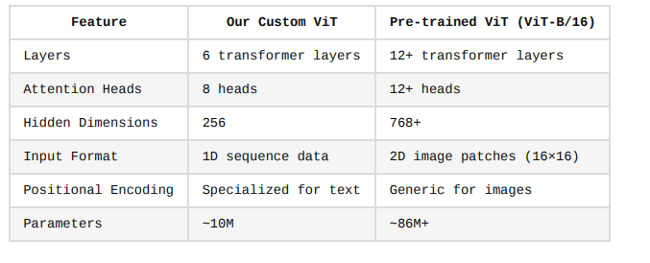
Why to choose vit for decoder
Why Custom ViT is Better for Our Task Lightweight & Efficient: 6 layers instead of 12+ reduces computation
Specialized for Text: Designed for sequential data, not image classification Direct Integration: Works directly with ResNet feature maps
Memory Efficient: 256 vs 768+ dimensions saves significant memory Task Specific: Focused on handwriting recognition, not general vision tasks
Inference Speed: Faster due to reduced complexity (~11ms per image)

Slide 38
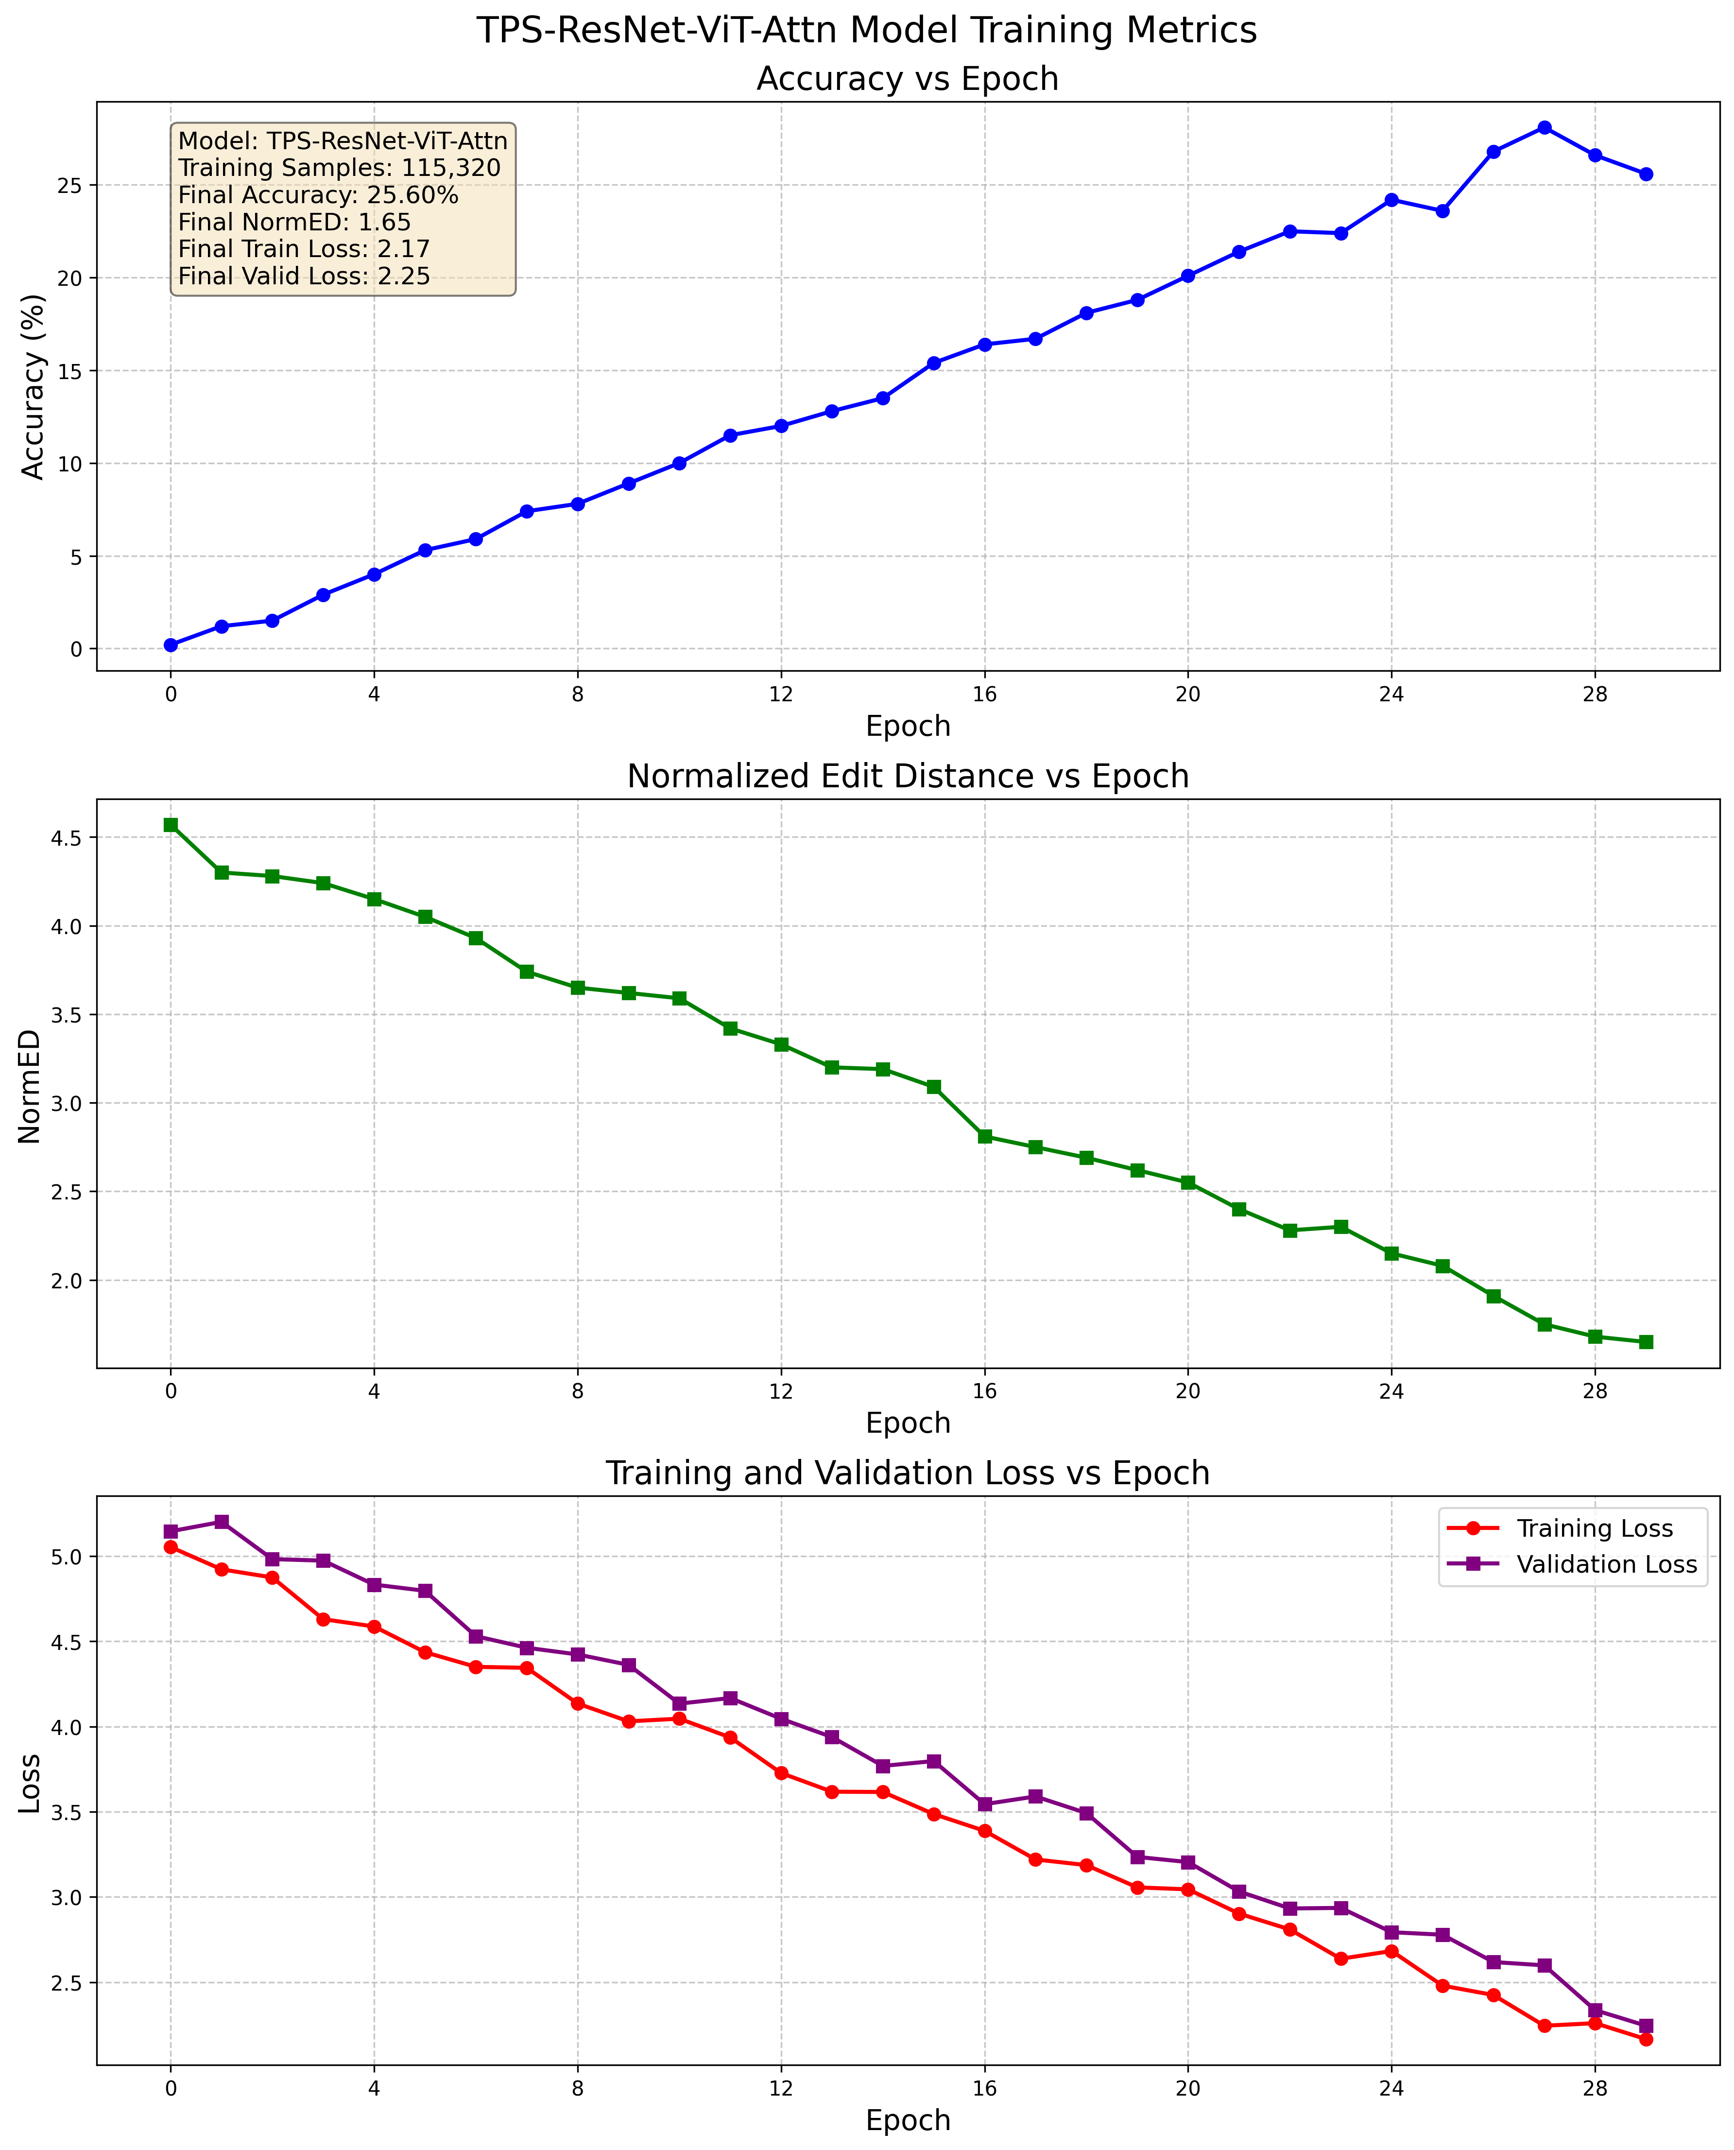
Graph results for training

Slide 39
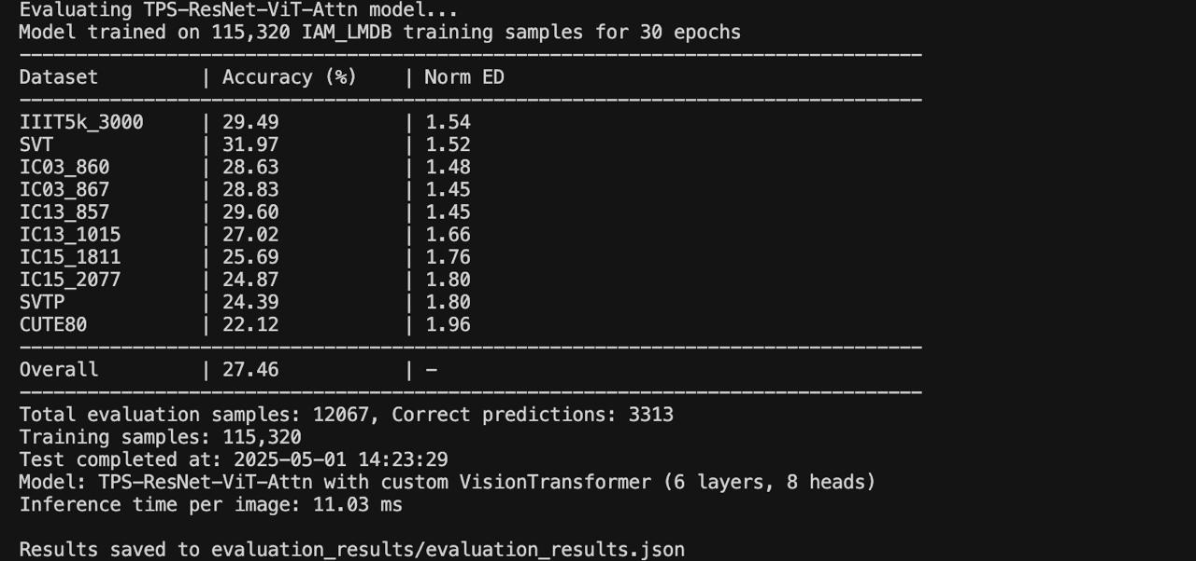
Test results for accuracy

Slide 40
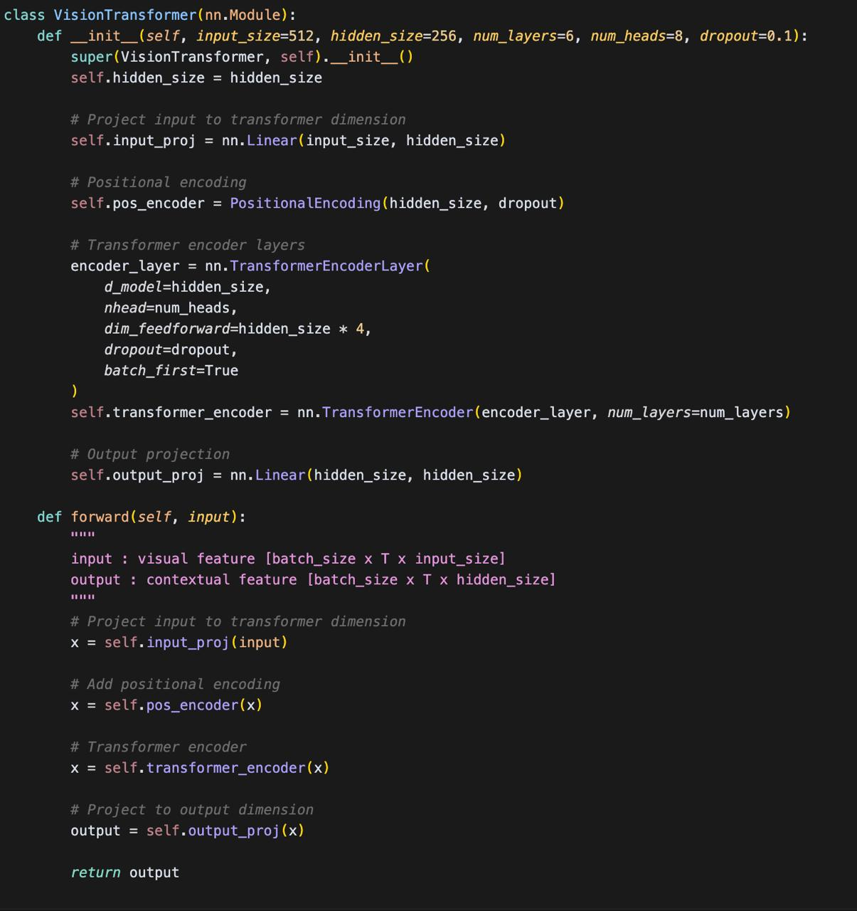
Class coded of custom vit decoder

Slide 41
Modification5(feature extraction layer resnet→vggmodel
Why VGG is chosen over ResNet
1)VGG converges quicker, making it easier to train on Handwritten datasets (like IAM dataset) 2)It achieves a great feature extraction quality due to its uniform filter design having 3x3 convolutional filters, and its depth having 16 layers 3)It has a clear feature hierarchy as each successive layer learns features at increasingly abstract semantic levels, and its layer-by-layer refinement using convolutional blocks, as well as maintaining spatial resolution throughout it
Advantages and disadvantages of vgg:
Advantages:
Simpler architecture - easier to understand and modify for HTR tasks Excellent feature extraction for fine-grained details in handwriting Uniform filter sizes create consistent receptive field growth
Disadvantages:
significantly larger model size (VGG16: 533MB vs. ResNet50: 102MB) Higher computational cost for inference - slower recognition speed Greater memory requirements due to large fully-connected layers

Slide 42
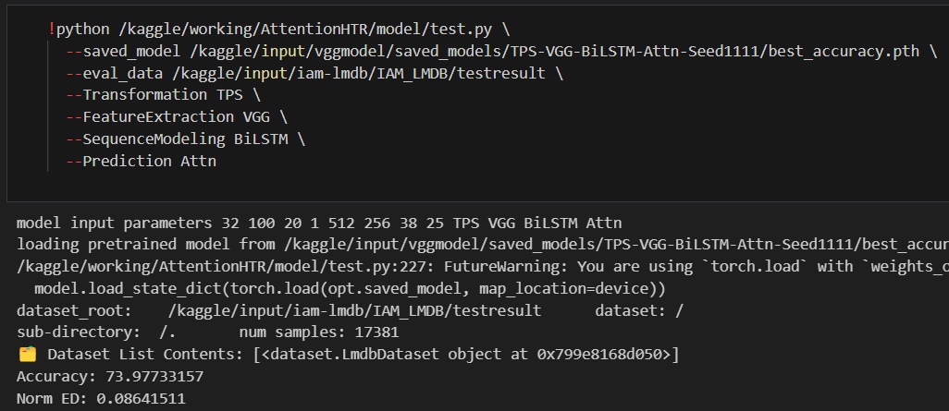
Tested accuracy results

Slide 43
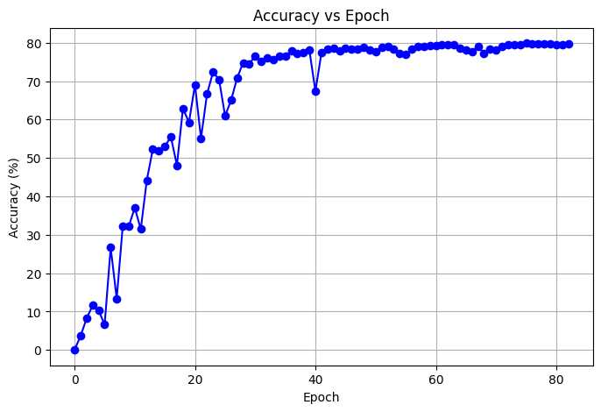
Accuracy(y-axis) vs epochs(x-axis) for vgg feature extraction based model pipeline

Slide 44
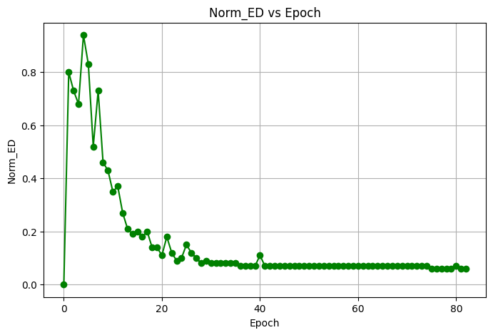
NORM_ED(normal edit distance)(y-axis) vs epochs(x-axis) for vgg feature extraction based model pipeline

Slide 45
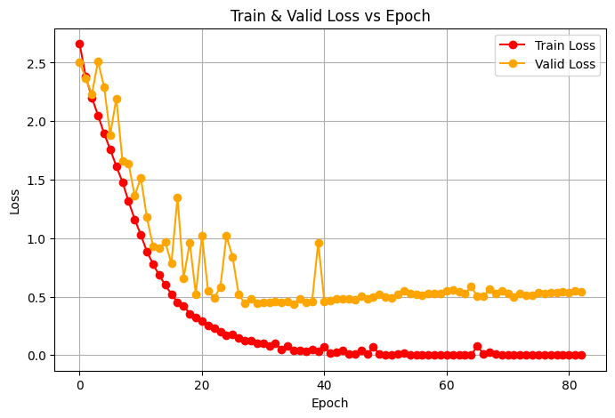
Train_loss and valid_loss(y-axis) vs epochs(x-axis) for vgg feature extraction based model pipeline

Slide 46
Bibliography and references
https://huggingface.co/docs/transformers/en/model_doc/vit
Neural ODE research paper: https://arxiv.org/pdf/1806.07366
Neural ODE reference code: https://github.com/msurtsukov/neural-ode/blob/master/Neural%20ODEs.ipynb
Base research paper of attention: HTR: https://arxiv.org/abs/2201.09390
Reference code of base research paper: https://github.com/dmitrijsk/AttentionHTR
matrix error fix: https://stackoverflow.com/questions/68039008/getting-error-with-two-matrices-multiplication-mat1-and-mat2-shapes-cannot-be-m
CUDA out of memory error:https://www.kaggle.com/discussions/getting-started/140636

